Slide 1
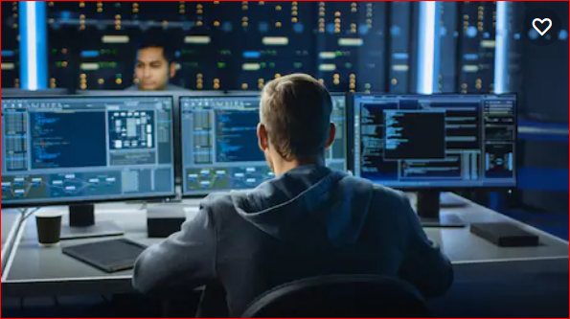
IT life is challenging!!!
“Technolopy makes it easier with servers and storage solutions that keep you in control of data security and customer experience”.

